Slide 1
Class 5
Sequence Alignment
Definitions (local / global)
Principle, BLAST +
Substitution matrices
Source of mistakes
Hard cases ..

Slide 2
Source of Molecular Data

Slide 3
DNA (nucleotide sequences) databases
They are big databases and searching either one should produce
similar results because they exchange information routinely.
-GenBank (NCBI): http://www.ncbi.nlm.nih.gov
-DDBJ (DNA DataBase of Japan): http://www.ddbj.nig.ac.jp
-TIGR: http://tigr.org/tdb/tgi
-Yeast: http://yeastgenome.org
-Microbes: http://img.jgi.doe.gov/cgi-bin/pub/main.cgi
Specialized databases:Tissues, species…
-ESTs (Expressed Sequence Tags)
~at NCBI http://www.ncbi.nlm.nih.gov/dbEST
~at TIGR http://tigr.org/tdb/tgi
- ...many more!
generic
organism specific
tissue specific

Slide 4
Protein (amino acid) databases
They are big databases too:
-Swiss-Prot (very high level of annotation)
http://au.expasy.org/
-PIR (protein identification resource) the world's most
comprehensive catalog of information on proteins
http://www.pir.uniprot.org/
Translated databases:
-TREMBL (translated EMBL): includes entries that have
not been annotated yet into Swiss-Prot.
http://www.ebi.ac.uk/trembl/access.html
-GenPept (translation of coding regions in GenBank)
-pdb (sequences derived from the 3D structure
Brookhaven PDB) http://www.rcsb.org/pdb/
Annotated/ manual
Automatic/ genomics
Structural

Slide 5
On molecular evolution

Slide 6
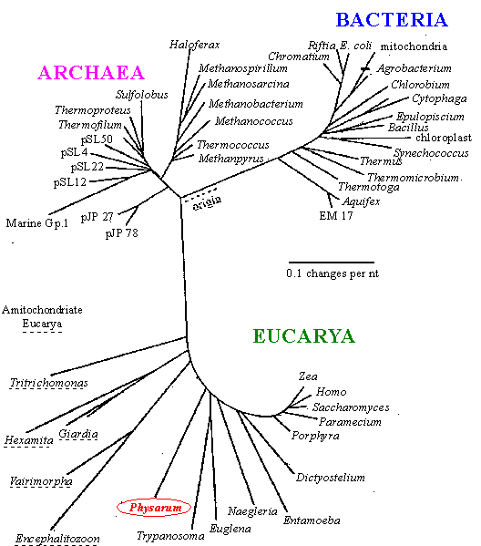
Sequences are related
Darwin: all organisms are related through descent with modification
=> Sequences are related through descent with modification
=> Related molecules have similar functions in different organisms
Phylogenetic tree based on ribosomal RNA:
three domains of life

Slide 7
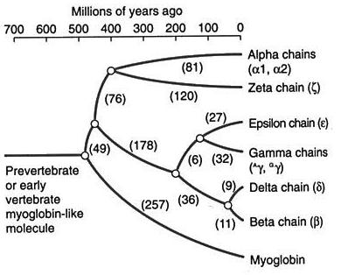
Sequences are related.. The story of gene duplication
Phylogenetic tree of globin-type proteins found in humans

Slide 8
Pairwise Alignment
Few terms…
A
Similar = no assumption of ‘evolutionary’ history
Identical = no assumption of ‘evolutionary’ history
Homologous seq = originated from a common ancestor
“Remote” homolog …
Transitivity in sequences
C
B

Slide 9
What for?
Determining whether 2 sequences from 2 entries found by search of keywords are similar/ identical
Focus on differences (genes sequenced in different labs, alternative splicing, SNPs, mutations.
Finding similar (conserved) regions in two sequences (domain)
Evolution rate, protein design , drug development, adaptation….

Slide 10
On sequence similarity
Homology: genes that derive from a common ancestor-gene are called homologs
Orthologous genes are homologous genes in different organisms
Paralogous genes are homologous genes in one organism that derive from gene duplication
Gene duplication: one gene is duplicated in multiple copies that therefore free to evolve and assume new functions

Slide 11
Causes for sequence (dis)similarity
mutation: a nucleotide at a certain location is replaced by
another nucleotide (e.g.: ATA → AGA)
insertion: at a certain location one new nucleotide is inserted inbetween two existing nucleotides (e.g.: AA → AGA)
deletion: at a certain location one existing nucleotide is deleted (e.g.: ACTG → AC-G)
indel: an insertion or a deletion

Slide 12
Pairwise alignment

Slide 13
Definition of Pairwise alignment
The process of lining up two or more sequences to achieve maximal levels of identity (or similarity, in the case of amino acid sequences).
Only 4 letters

Slide 14
Definitions
Conservation
The extent to which nucleotide or protein sequences are related. It can be evaluated by identity and similarity.
Identity ( | )
The extent to which two sequences are invariant.
Similarity ( . : )
Changes at a specific position of an amino acid that preserve the physico-chemical properties of the original residue.
Page 47

Slide 15
How do we align two sequences?
ATTGCAGTGATCG
ATTGCGTCGATCG
Solution 1 Solution 2
ATTGCAGTGATCG ATTGCAGT-GATCG
||||| ||||| ||||| || |||||
ATTGCGTCGATCG ATTGC-GTCGATCG
10 matches | , 3 mismatches
12 matches |, 2 gaps -

Slide 16
Which alignment is better?
Solution 1 Solution 2
ATTGCAGTGATCG ATTGCAGT-GATCG
||||| ||||| ||||| || |||||
ATTGCGTCGATCG ATTGC-GTCGATCG
We will use a scoring scheme
Match +1 +1
Mismatch –1 0
Indel(gap) -2 -2
10 matches, 3 mismatches
12 matches, 2 gaps
10X1+3X(-1) = 7
12X1+2X(-2) = 8
10X1+3X(0) = 10
12X1+2X(-2) = 8

Slide 17
Global alignment: Scoring
Reward for matches: 10
Mismatch penalty: 2
Space penalty: 5
C T G T C G – C T G C
- T G C – C G – T G -
-5 10 10 -2 -5 -2 -5 -5 10 10 -5
Total = 11

Slide 18
Biological causes of mismatches
Accumulation of mutations in a segment of the sequence that is less crucial for function can create a stretch of mismatches.
(Any residue can be subject to back mutations.)
Very common.
ATTGCAGTGATCG
||||| |||||
ATTGCGTCGATCG
ATTGCAGTGATCG
||||| | |||||
ATTGCGGCGATCG
Original sequence
Emerging sequence
Original sequence
May reflect 2 or 4 independent mutations
Emerging sequence

Slide 19
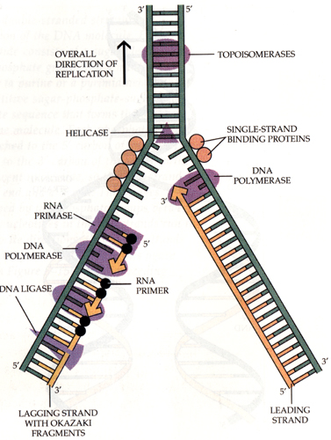
Changing the scores of the matrix scheme can change the final score of a given aligned segment.
Knowing the mechanism of duplication

Slide 20
Dealing with gaps

Slide 21
Are all gaps equal?
Biological causes of gaps (indel – insertion / deletion)
A single mutation can create a gap .
Unequal crossover in meiosis can lead to insertion or deletion of strings of bases.
DNA slippage in the replication procedure can result in the repetition of a string.
Retrovirus insertions.
Translocations of DNA between chromosomes.
All these events are LESS common than events leading to single mutations

Slide 22
Consider the following pair of sequences:
A sequence with a short gap: ATCTTCAGTGTTTCCCCTGTTTTGCCC.ATTTAGTTCGCTC ||||||||||||||||||||||||||| ||||||||||||| ATCTTCAGTGTTTCCCCTGTTTTGCCCGATTTAGTTCGCTC
A sequence with a long gap: ATCTTCAGTGTTTCCCCTGTTTTGCCC....................ATTTAGTTCGCTC ||||||||||||||||||||||||||| ||||||||||||| ATCTTCAGTGTTTCCCCTGTTTTGCCCGXXXXXXXXXXXXXXXXXXXATTTAGTTCGCTC
Two options for gap scoring
Keep the score similar regardless of gap length = just penalize when you open a gap.
Make the score become larger as a linear function of gap length = penalize several small gaps by the same extent as 1 large gap.

Slide 23
Advance: Gap penalties can penalize for:
Gap opening
Gap extension
Gap ending (for multiple alignment)
Gap separation (minimum distance between 2 gaps)

Slide 24
Ex: Pairwise alignments (proteins)
43.2% identity;
Global alignment score: 374
10 20 30 40 50
alpha V-LSPADKTNVKAAWGKVGAHAGEYGAEALERMFLSFPTTKTYFPHF-DLS-----HGSA
: :.: .:. : : :::: .. : :.::: :... .: :. .: : ::: :.
beta VHLTPEEKSAVTALWGKV--NVDEVGGEALGRLLVVYPWTQRFFESFGDLSTPDAVMGNP
10 20 30 40 50
60 70 80 90 100 110
alpha QVKGHGKKVADALTNAVAHVDDMPNALSALSDLHAHKLRVDPVNFKLLSHCLLVTLAAHL
.::.::::: :.....::.:.. .....::.:: ::.::: ::.::.. :. .:: :.
beta KVKAHGKKVLGAFSDGLAHLDNLKGTFATLSELHCDKLHVDPENFRLLGNVLVCVLAHHF
60 70 80 90 100 110
120 130 140
alpha PAEFTPAVHASLDKFLASVSTVLTSKYR
:::: :.:. .: .:.:...:. ::.
beta GKEFTPPVQAAYQKVVAGVANALAHKYH
120 130 140

Slide 25
Global vs Local
L G P S S K Q T G K G S - S R I W D N
Global alignment
L N - I T K S A G K G A I M R L G D A
- - - - - - - T G K G - - - - - - - -
Local alignment
- - - - - - - A G K G - - - - - - - -

Slide 26
Global alignment An alignment that assumes that the two proteins are basically similar over the entire length of one another. The alignment attempts to match them to each other from end to end, even though parts of the alignment are not very convincing.
A short example
NLGPSTKDFGKISESREFDNQ
| |||| |
QLNQLERSFGKINMRLEDALV

Slide 27
Local alignment An alignment that searches for segments of the two sequences that match well. There is no attempt to force entire sequences into an alignment, just those parts that appear to have good similarity, according to some criterion.
Using the same sequences as above, one could get:
NLGPSTKDDFGKILGPSTKDDQ
||||
QNQLERSSNFGKINQLERSSNN
Can you propose (biological) logic for applying LOCAL or GLOBAL

Slide 28
When LOCAL fails
When GLOBAL fails

Slide 29
A good alignment with end-gaps
A very poor alignment
BUT ~ 50% identity!
MANY reasons for translating
Conservation of protein in evolution (DNA similarity decays faster!)

Slide 30
DNA Substitution Matrices
Not all substitutions are equal
Hard to model!
Purine – Purine
Pyrimidine - Pyrimidine
Purine – Pyrimidine
Pyrimidine - Purine

Slide 31
The substitution matrix
A more realistic scoring function is given by the biologically inspired substitution matrix :
- A G C T
A 10 -1 -3 -4
G -1 7 -5 -3
C -3 -5 9 0
T -4 -3 0 8

Slide 32
The substitution matrix
A more realistic scoring function is given by the biologically inspired substitution matrix :
- A G C T
A 10 -1 -3 -4
G -1 7 -5 -3
C -3 -5 9 0
T -4 -3 0 8
then the alignment: AGACTAGTTAC
CGA---GACGT

Slide 33
Algorithms
Needleman-Wunsch
Pairwise global alignment only.
Smith-Waterman
Pairwise, local (or global) alignment.
BLAST
Pairwise heuristic local alignment

Slide 34
The substitution matrix
A more realistic scoring function is given by the biologically inspired substitution matrix :
- A G C T
A 10 -1 -3 -4
G -1 7 -5 -3
C -3 -5 9 0
T -4 -3 0 8

Slide 35
Dot matrix analysis: A snapshot of evolution
comparing two sequences to look for possible alignment (1970)
One sequence (A) is listed across the top of the matrix and the other (B) is listed down the left side
Any region of similarity is revealed by a diagonal row of dots
Isolated dots not on diagonal represent random matches

Slide 36
From DNA to proteins

Slide 37
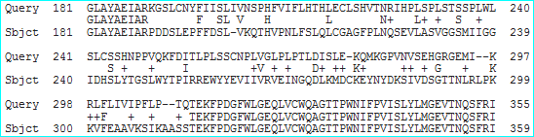
Dotplot: BRCA1 in human and Gorilla only conserve identity or not…

Slide 38
Pairwise alignments: conservative substitutions
43.2% identity; Global alignment score: 374
10 20 30 40 50
alpha V-LSPADKTNVKAAWGKVGAHAGEYGAEALERMFLSFPTTKTYFPHF-DLS-----HGSA
: :.: .:. : : :::: .. : :.::: :... .: :. .: : ::: :.
beta VHLTPEEKSAVTALWGKV--NVDEVGGEALGRLLVVYPWTQRFFESFGDLSTPDAVMGNP
10 20 30 40 50
60 70 80 90 100 110
alpha QVKGHGKKVADALTNAVAHVDDMPNALSALSDLHAHKLRVDPVNFKLLSHCLLVTLAAHL
.::.::::: :.....::.:.. .....::.:: ::.::: ::.::.. :. .:: :.
beta KVKAHGKKVLGAFSDGLAHLDNLKGTFATLSELHCDKLHVDPENFRLLGNVLVCVLAHHF
60 70 80 90 100 110
120 130 140
alpha PAEFTPAVHASLDKFLASVSTVLTSKYR
:::: :.:. .: .:.:...:. ::.
beta GKEFTPPVQAAYQKVVAGVANALAHKYH
120 130 140
Same identity ( % )
Very different outcome in tern of conservation and function

Slide 39
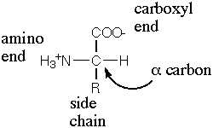
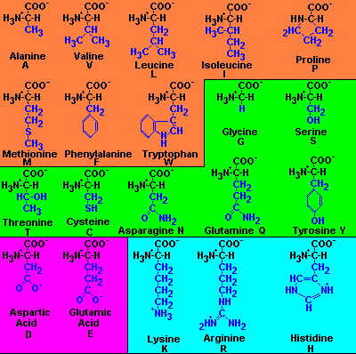
All Amino Acids Are Equal…
Non-polar hydrophobic
All other aa are polar, hydrophylic:
Acidic
Basic

Slide 40
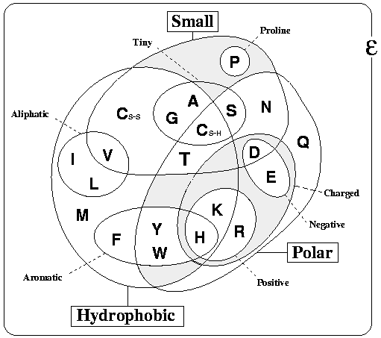
So how can we score matches and mismatches?

Slide 41
Amino acids substitution matrices were developed
(Blosum, PAM).
Why use a substitution matrix?
Determine likelihood of homology between two sequences.
Substitutions that are more likely should get a higher score,
Substitutions that are less likely should get a lower score.

Slide 42
Amino Acids Substitution Matrices
The PAM and BLOSUM substitution matrices describe the likelihood that two residue types would mutate to each other.
These matrices are based on biological sequence information:
the substitutions observed in structural (BLOSUM) or evolutionary (PAM)
Based on the alignments of well studied protein families
These scoring systems have a probabilistic foundation.

Slide 43
PAM series - Percent Accepted Mutation
(Accepted by natural selection)
All the PAM data come from alignments of closely
related proteins (>85% amino acid identity) from 71 protein families (total of 1572 protein sequences).
PAM matrices are based on global sequence alignments - these include both highly conserved and highly mutable regions.
Some of the protein families are:
Ig kappa chain
Kappa casein
Lactalbumin
Hemoglobin α
Myoglobin
Insulin
Histone H4
Ubiquitin

Slide 44
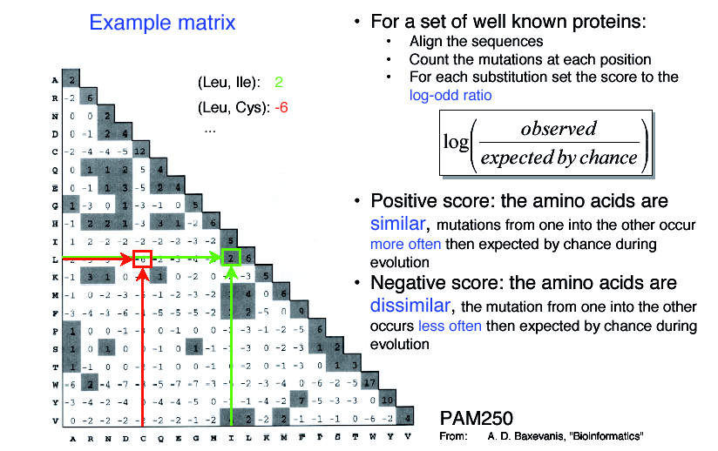
PAM series - Percent Accepted Mutation
(Accepted by natural selection)
Varying degrees of conservation
*
PAM1 99% identity in sequences
i.e. one change has occurred over a length of 100 amino acids.

Slide 45
Various degrees of conservation
The PAM 250 matrix is appropriate for searching for alignments of sequence that have diverged by 250 PAMs, 250 mutations per 100 amino acids of sequence.
Because of back mutations and silent mutations this corresponds to sequences that are about ~20 percent identical.

Slide 46
Creating a substitution matrix
Very similar sequences were aligned.
From these alignments, the frequency of substitution between each pair of aa was calculated and then PAM1 was built.
After normalizing to log-odds format, the full series of PAM matrices can be calculated by multiplying the PAM1 matrix by itself.

Slide 47
Devising a scoring system
 Log-odds matrices, a normalisation method for matrix values:
S is the probability that two residues, i and j, are aligned by evolutionary descent
and by chance.
q_{ij} are the frequencies that i and j are observed to align in sequences known to
be related. p_{i} and p_{j} are their frequencies of occurrence in the set of sequences.

Slide 48
BLOSUM (BLOcks amino acid SUbstitution Matrix)
(many hidden / wrong) but THE MOST USEFUL MATRIX for BIOLOGY
Each matrix is tailored to a particular evolutionary distance.
BLOSUM62 matrix, - alignment from which scores were derived was created using sequences sharing no more than 62% identity.
Sequences more identical than 62% are represented by a single sequence in the alignment so as to avoid over-weighting closely related family members.

Slide 49
Blosum62 scoring matrix
Likelihood of a substitution is STRONGLY affected by the degree of de-generativity of the genetic code for each aa

Slide 50
How do we choose the most appropriate scoring matrix?
(A cookbook view..)
Blosum matrices are more commonly used than PAM matrices.
The Blosum matrices are best for detecting local alignments.
The Blosum62 matrix is the best for detecting the majority of weak protein similarities.
The Blosum45 matrix is the best for detecting long and weak alignments.

Slide 51
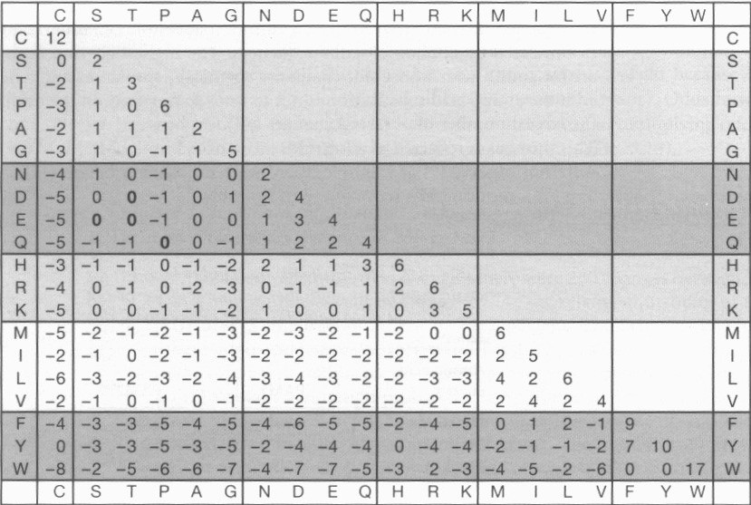
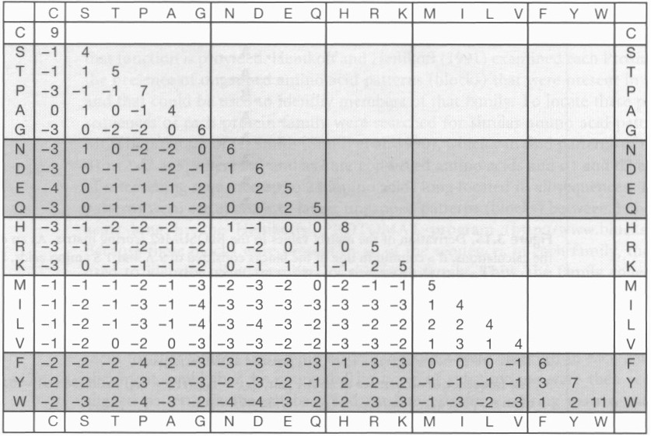
PAM 250
Blosum 62

Slide 53
Limitations
• Substitution matrices do not take into account long range interactions between residues.
• They assume that identical residues are equal (whereas in real life a residue at the active site has other evolutionary constraints than the same residue outside of the active site)
• They assume evolution rate to be constant.

Slide 54
Calculating alignment scores
The raw score S is calculated by summing the scores for each aligned
position and the scores for gaps. Gap creation/extension scores are
inherent to the scoring system in use (BLAST, FASTA…)
The score for an identity or a mismatch is given by the specified substitution matrix (e.g., BLOSUM62).

Slide 55
Database search

Slide 56
Database homology searching
Use algorithms to efficiently provide mathematical basis of searches
that can be translated to statistical significance.
Assumes that sequence, structure, and function are inter-related.
All similarity searching methods rely on the concepts of alignment
and distance between sequences.
A similarity score is calculated from a distance: the “number” of DNA
bases or amino acids that are different between two sequences.
T.H.M.
WHAT IS THE EXPECTATION TO ACHIEVE SUCH LEVEL OF SIMILARITY
THE SCALE OF DATA … MANY RANDOM SIMILARITES …

Slide 57
Database search methods: Sequence Alignment
The most widely used local similarity algorithms are:
Smith-Waterman (http://www.ebi.ac.uk/MPsrch/)
Basic Local Alignment Search Tool (BLAST, http://www.ncbi.nih.gov)
Fast Alignment (FASTA, http://fasta.genome.jp; http://www.ebi.ac.uk/fasta33/;
http://www.arabidopsis.org/cgi-bin/fasta/nph-TAIRfasta.pl)

Slide 58
BLAST: fast approximate alignment
Fast but heuristic
Most used algorithm in bioinformatics
Verb: to blast

Slide 59
BLAST: fast approximate alignment
Fast but heuristic
Most used algorithm in bioinformatics
Verb: to blast

Slide 60
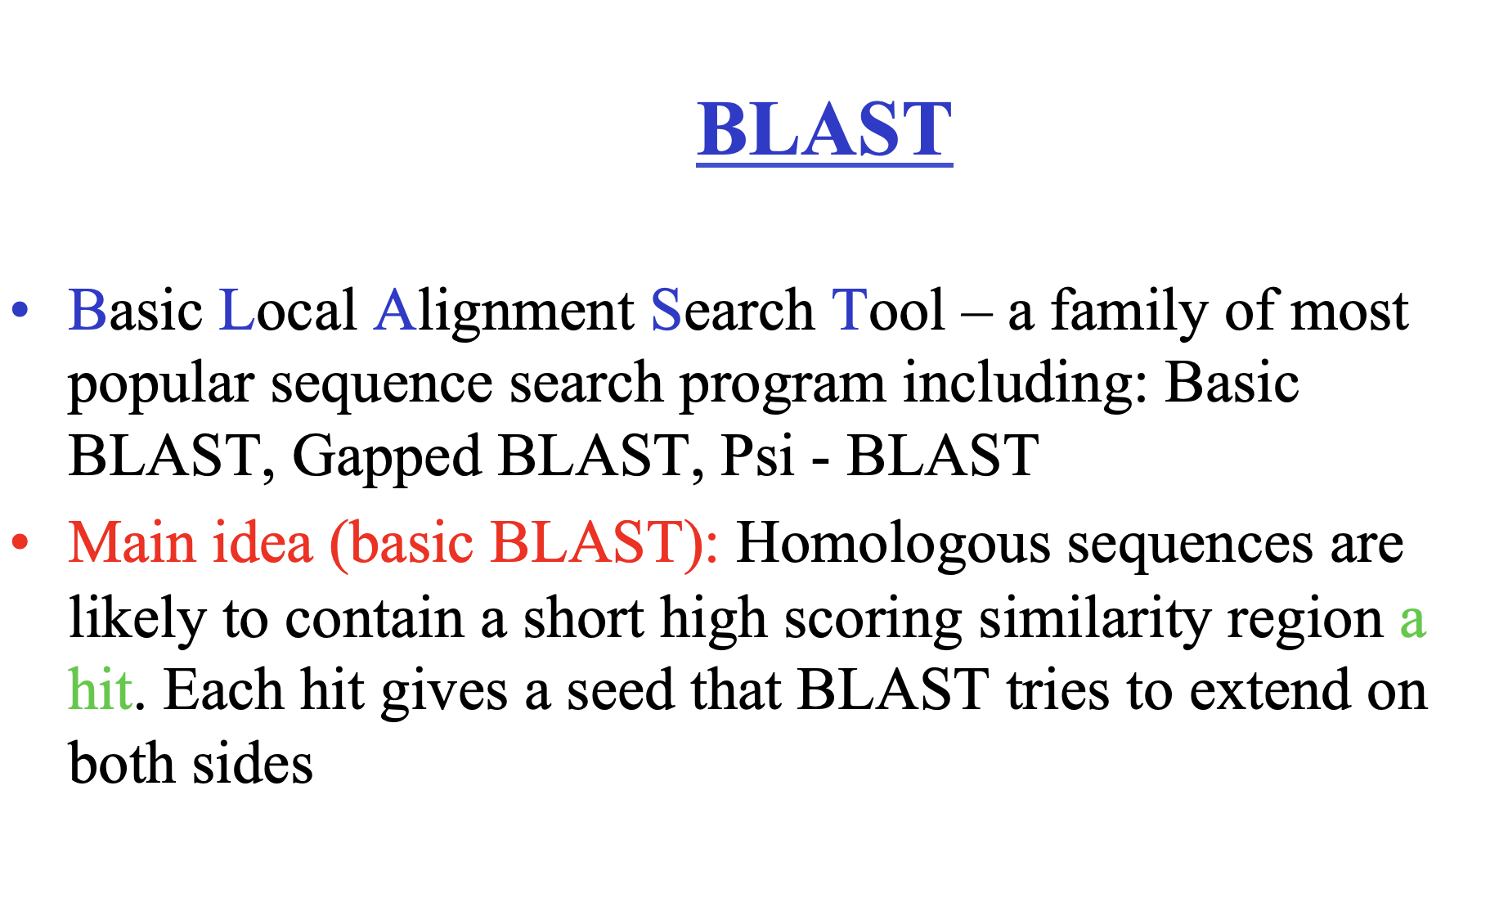

Slide 61
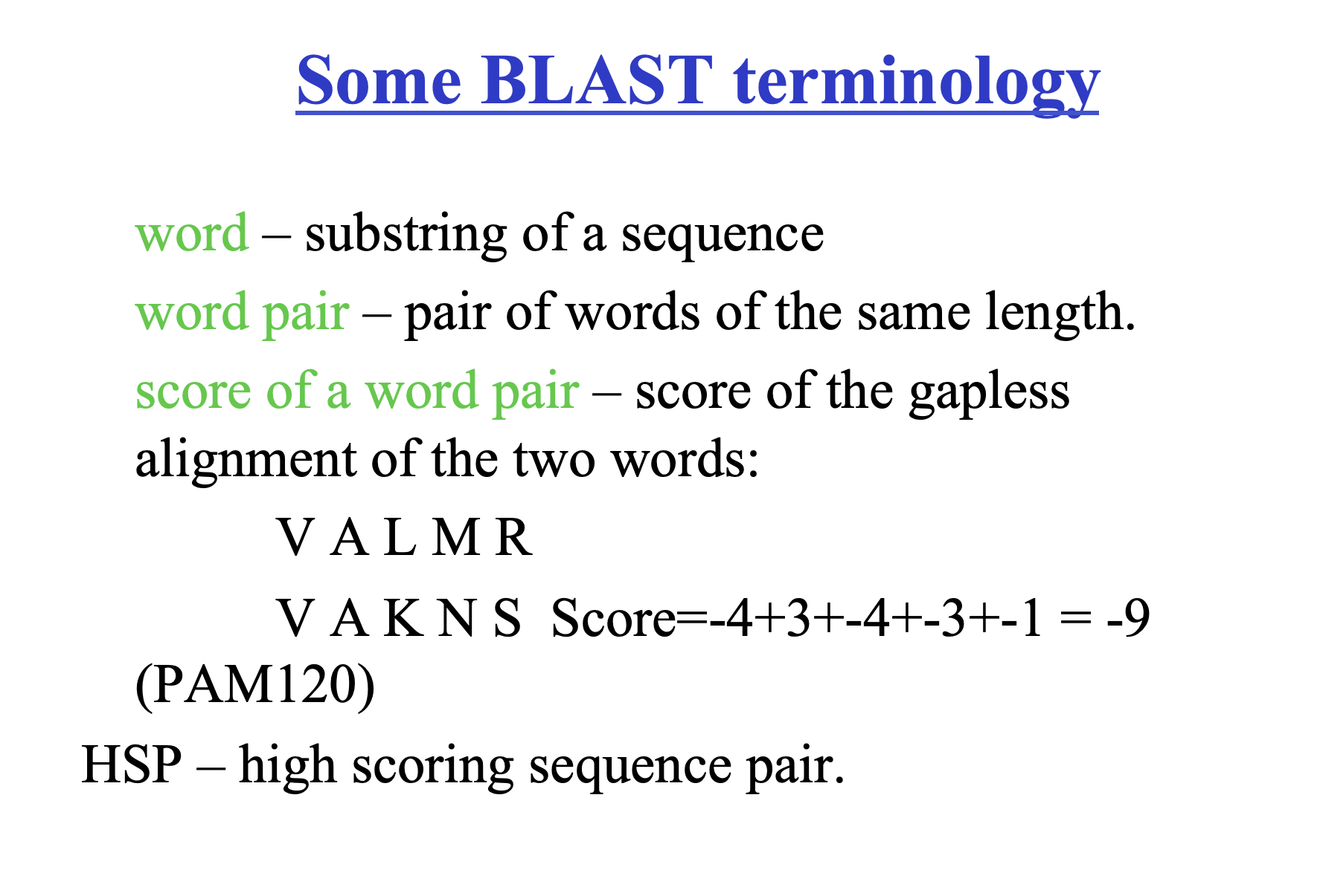

Slide 62
For BLAST tutorial
http://www.ncbi.nlm.nih.gov/BLAST/

Slide 63
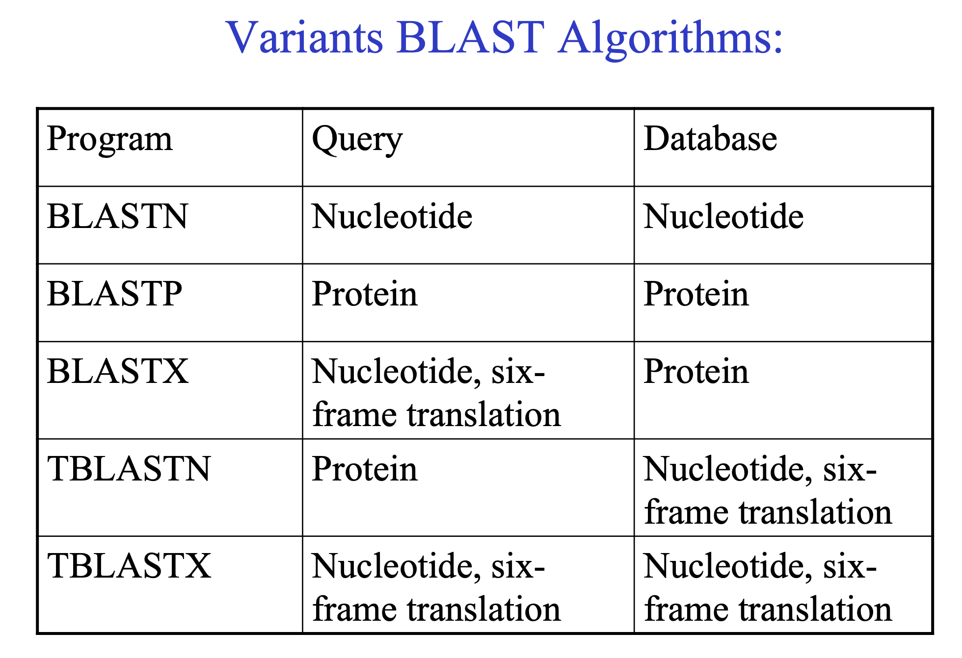

Slide 64
Which algorithm to use for database similarity search?
Speed:
BLAST > FASTA > SW, Smith-Waterman (It is VERY SLOW and uses a LOT OF COMPUTER POWER)
Sensitivity/statistics:
FASTA is more sensitive, misses less homologues
SW is even more sensitive.
BLAST calculates probabilities
FASTA more accurate for DNA-DNA search then BLAST

Slide 65
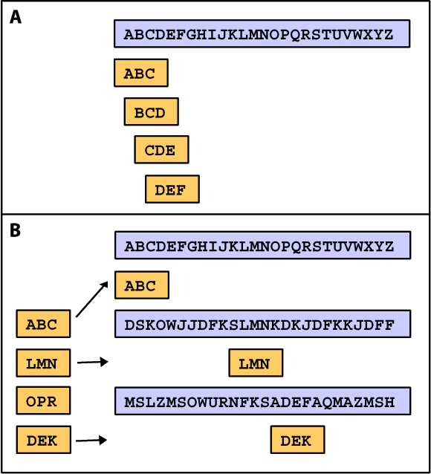
Κ-tuple methods provide optimal alignments
These methods are faster and excellent in comparing sequences.
BLAST and FASTA programs are based on Κ-tuple algorithms:
1-Using query sequence, derive a list of
words of length w (e.g., 3)
2-Keep high-scoring words using a
scoring matrix(e.g. BLOSUM 62)
3-High-scoring words are compared
with database sequences
4-Sequences with many matches to
high-scoring words are used for final
alignments

Slide 66
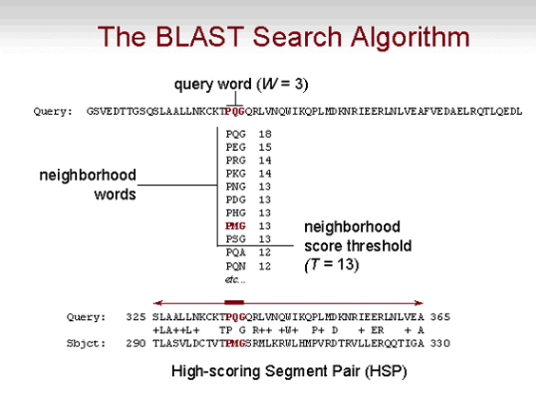

Slide 67
BLAST and FASTA variants
FASTA: Compares a DNA query to DNA database, or a protein query
to protein database
FASTX: Compares a translated DNA query to a protein database
TFASTA: Compares a protein query to a translated DNA database
BLASTN: Compares a DNA query to DNA database.
BLASTP: Compares a protein query to protein database.
BLASTX: Compares the 6-frame translations of DNA query to protein
database.
TBLASTN: Compares a protein query to the 6-frame translations of a DNA
database.
TBLASTX: Compares the 6-frame translations of DNA query to the 6-frame
translations of a DNA database (each sequence is comparable to
BLASTP searches!)
PSI-BLAST: Performs iterative database searches. The results from each round
are incorporated into a 'position specific' score matrix, which is
used for further searching

Slide 68
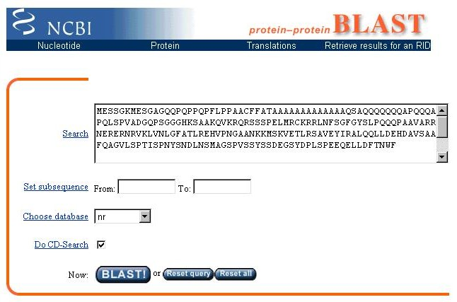
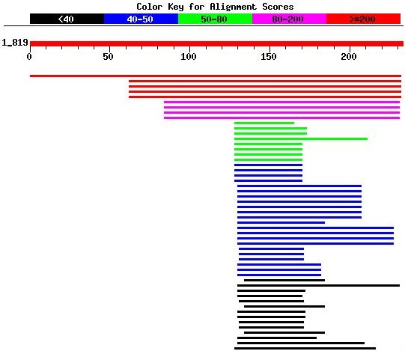
A practical example of sequence alignment
http://www.ncbi.nlm.nih.gov
BLAST results

Slide 69
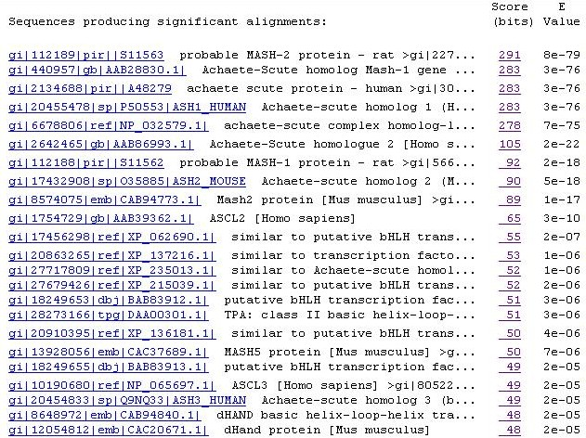
Detailed BLAST results
significant the score.
E value: is the expectation value or probability to find by chance hits similar to your sequence.
The lower the E, the more significance is the alignment

Slide 70
Database searching tips
Use latest database version.
Use BLAST first, then a finer tool (FASTA,…)
Search both strands when using FASTA.
Translate sequences where relevant
Search 6-frame translation of DNA database
E < 0.05 is statistically significant, usually biologically interesting.
If the query has repeated segments, delete them and repeat search
From Experience: Break a sequence to segment and realign
Change!! the parameters of the BLAST
Apply non redundant DB

Slide 71
Database searching tips
Use latest database version.
Use BLAST first, then a finer tool (FASTA,…)
Search both strands when using FASTA.
Translate sequences where relevant
Search 6-frame translation of DNA database
E < 0.05 is statistically significant, usually biologically interesting.
If the query has repeated segments, delete them and repeat search
From Experience: Break a sequence to segment and realign
Change!! the parameters of the BLAST
Apply non redundant DB

Slide 72
Database searching tips
Use latest database version.
Use BLAST first, then a finer tool (FASTA,…)
Search both strands when using FASTA.
Translate sequences where relevant
Search 6-frame translation of DNA database
E < 0.05 is statistically significant, usually biologically interesting.
If the query has repeated segments, delete them and repeat search
From Experience: Break a sequence to segment and realign
Change!! the parameters of the BLAST
Apply non redundant DB

Slide 73
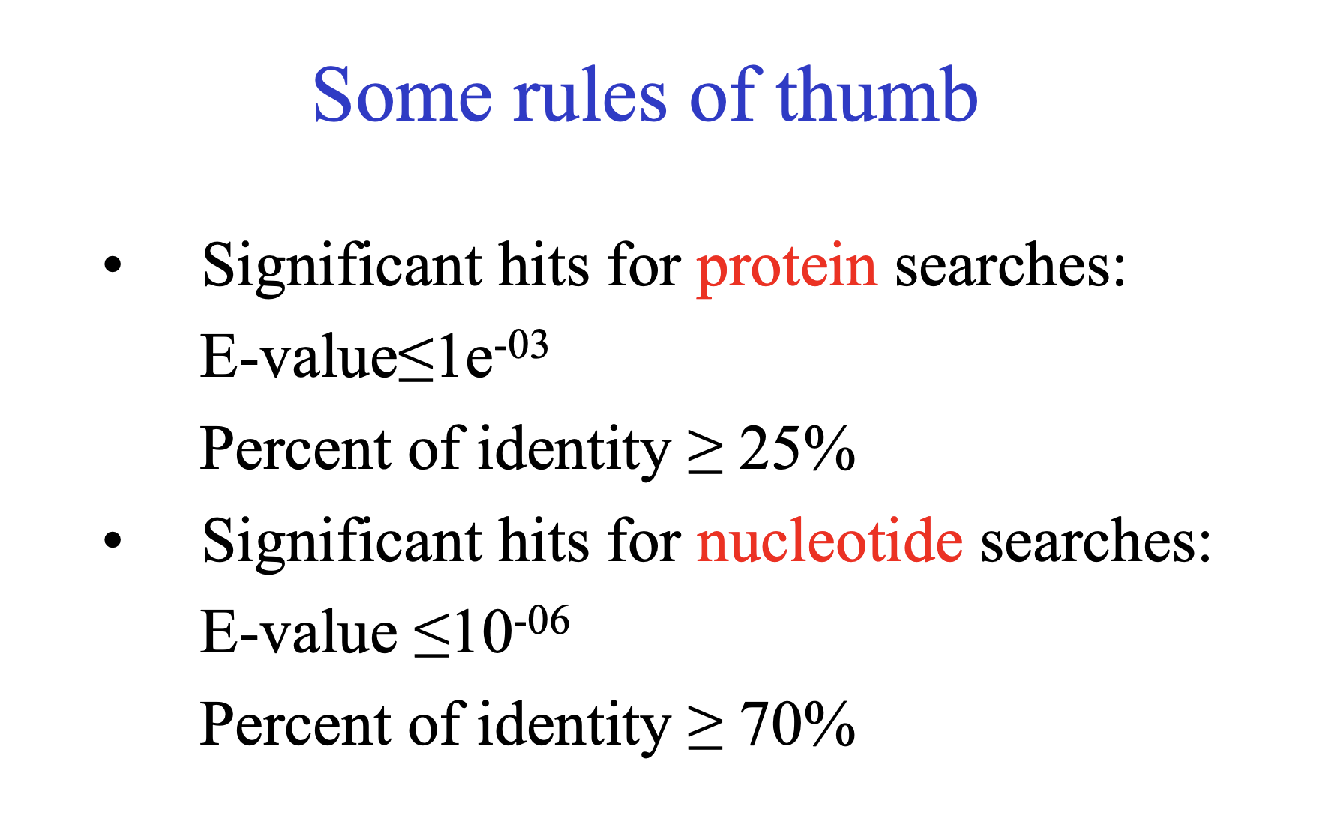

Slide 74
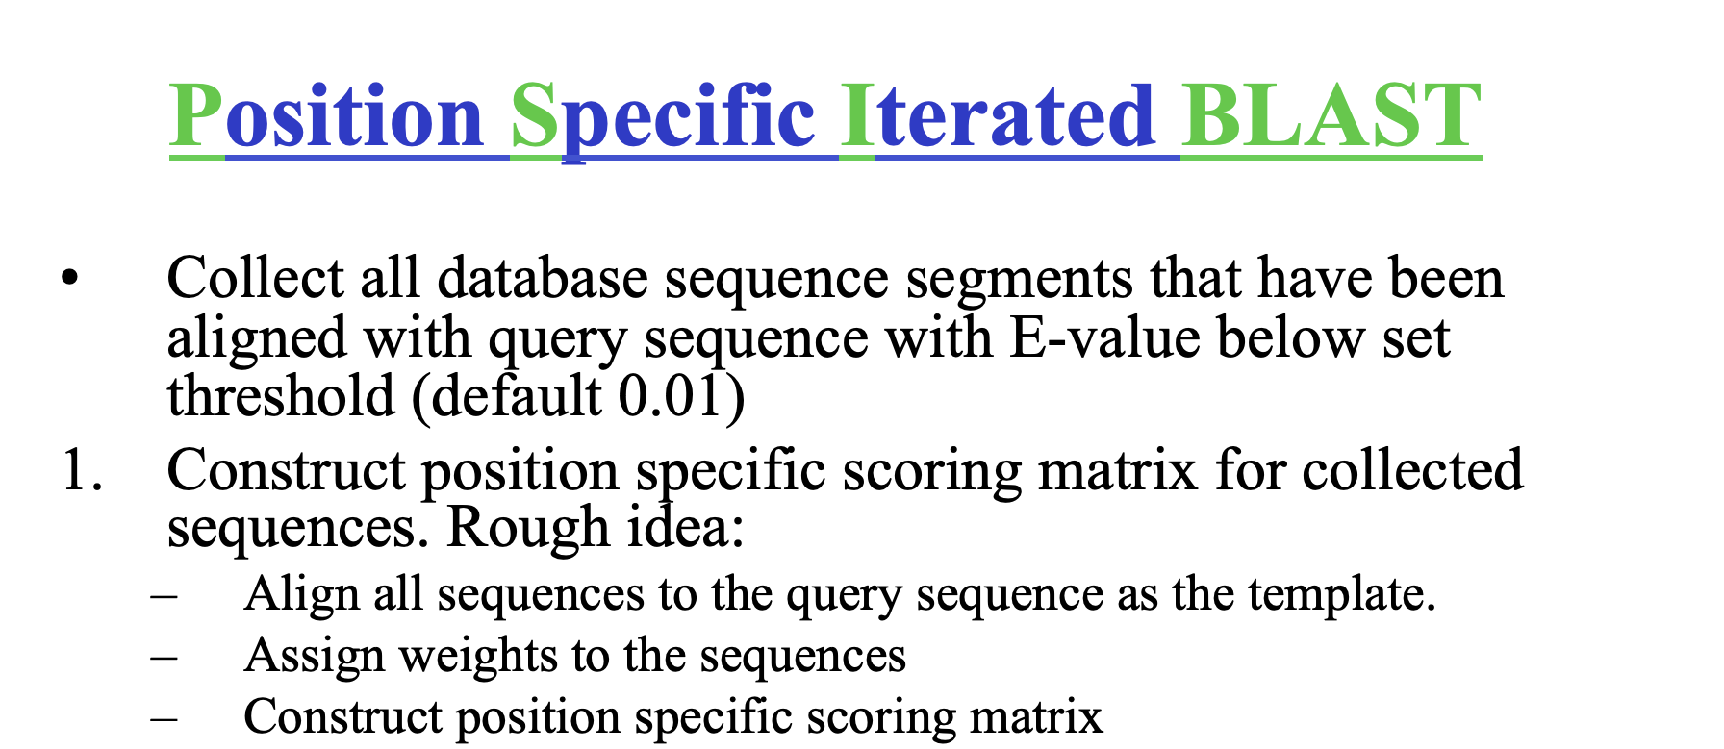

Slide 75
Multiple Sequence Alignment
(MSA)

